Slide 1
Stroke Risk Stratification: Identifying Vulnerable Individuals Through Data Visualization
Joshua Okojie
Lindsay Hudson
Mariluz Lopez Zamora

Slide 2
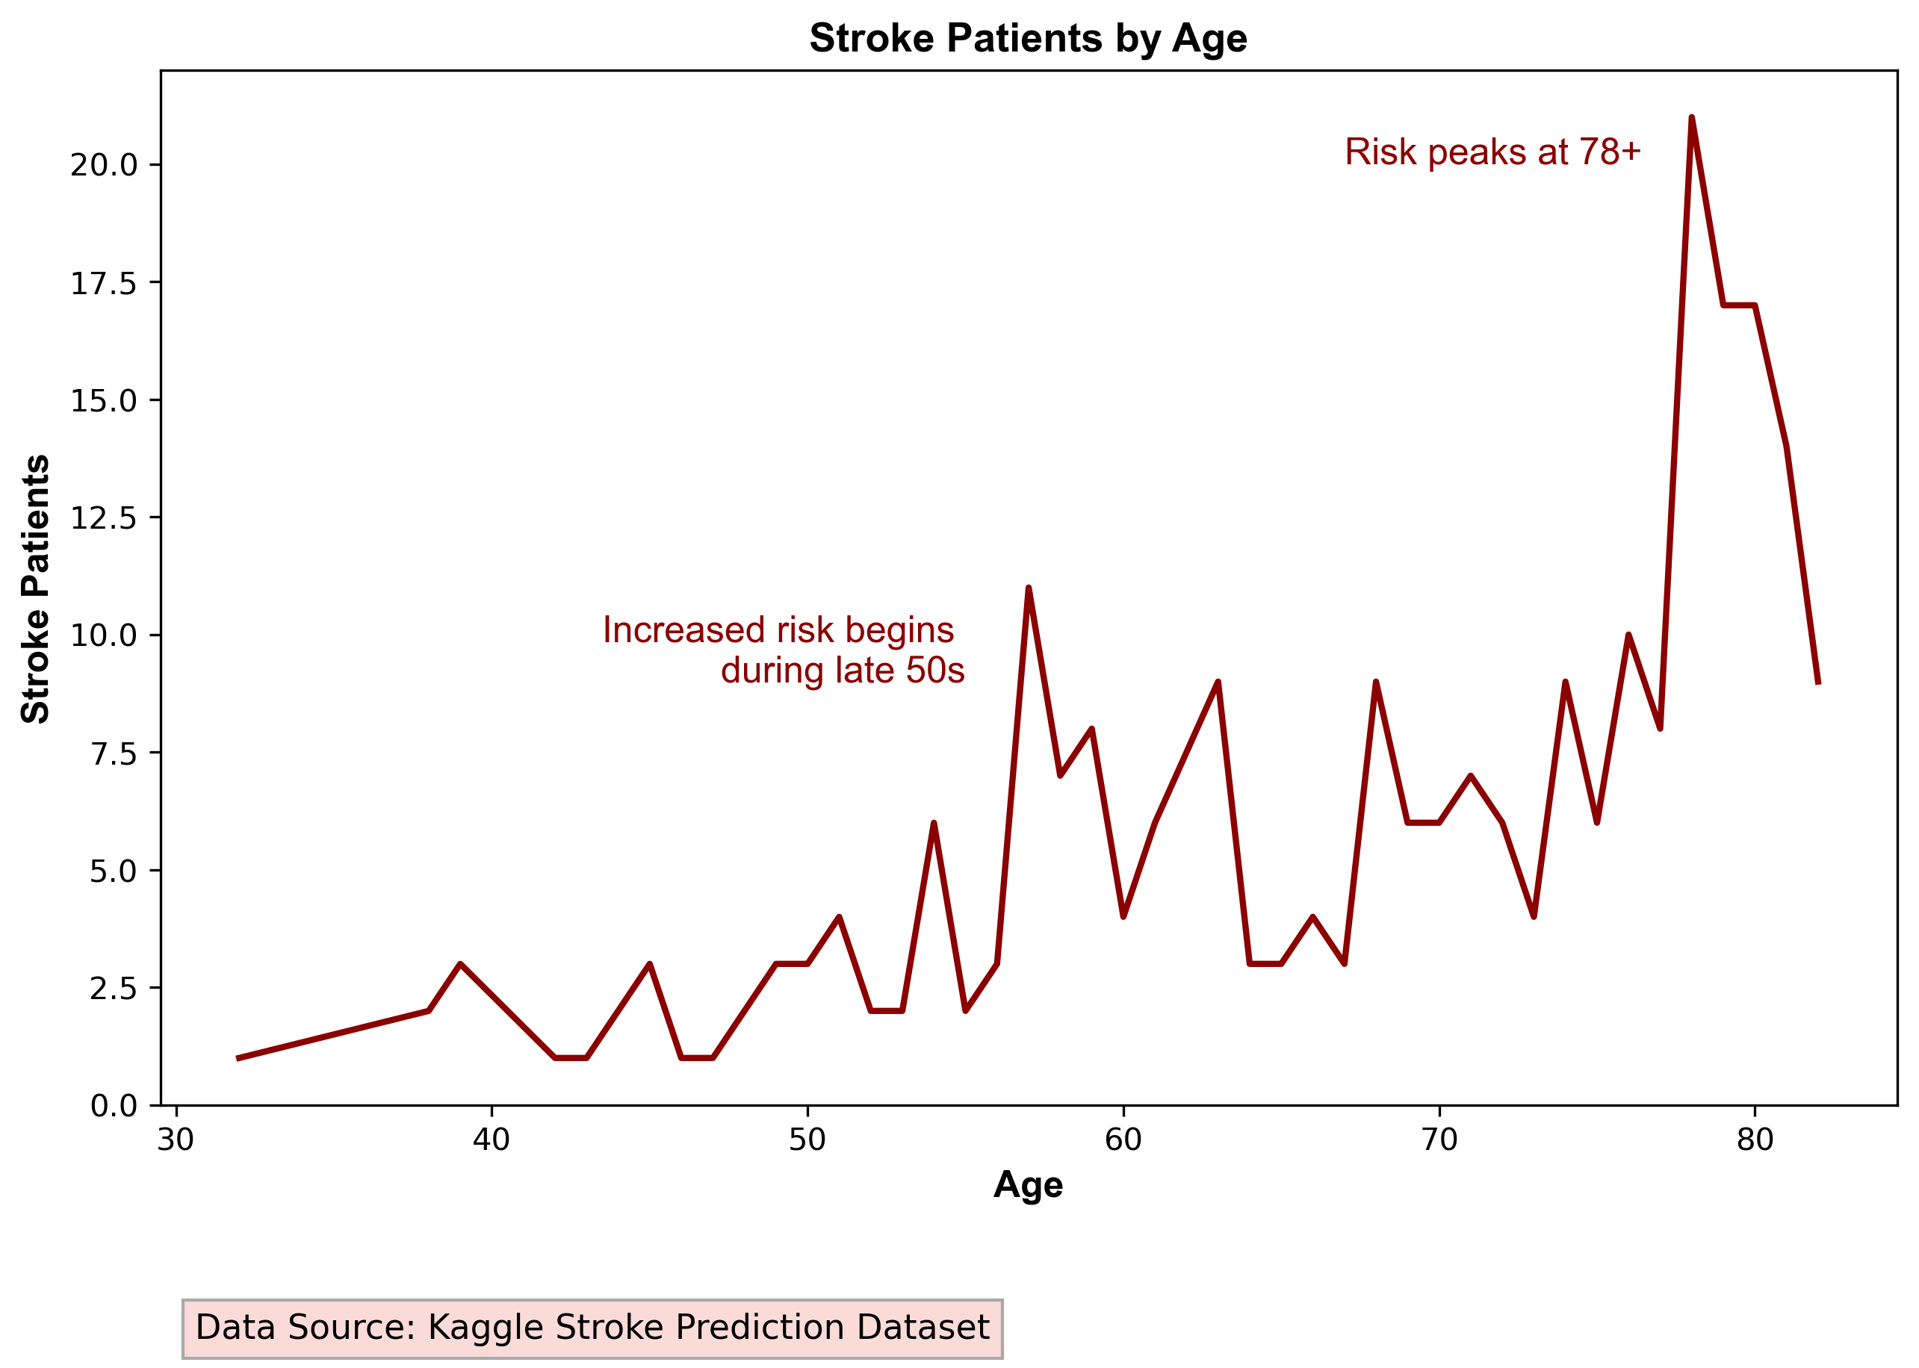
Objectives:
Analyze and visualize the stroke prediction dataset.
Develop a target model identifying individuals most at risk of suffering a stroke.
Support: preventive measures and public health campaigns.
Notes:
Lindsay

Slide 3
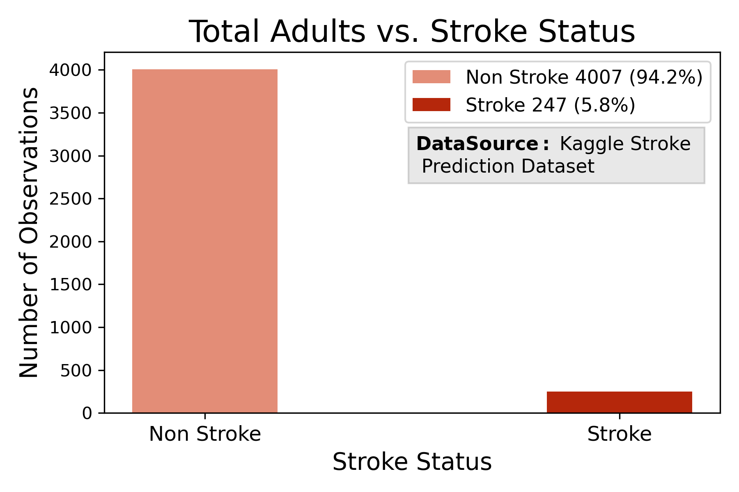
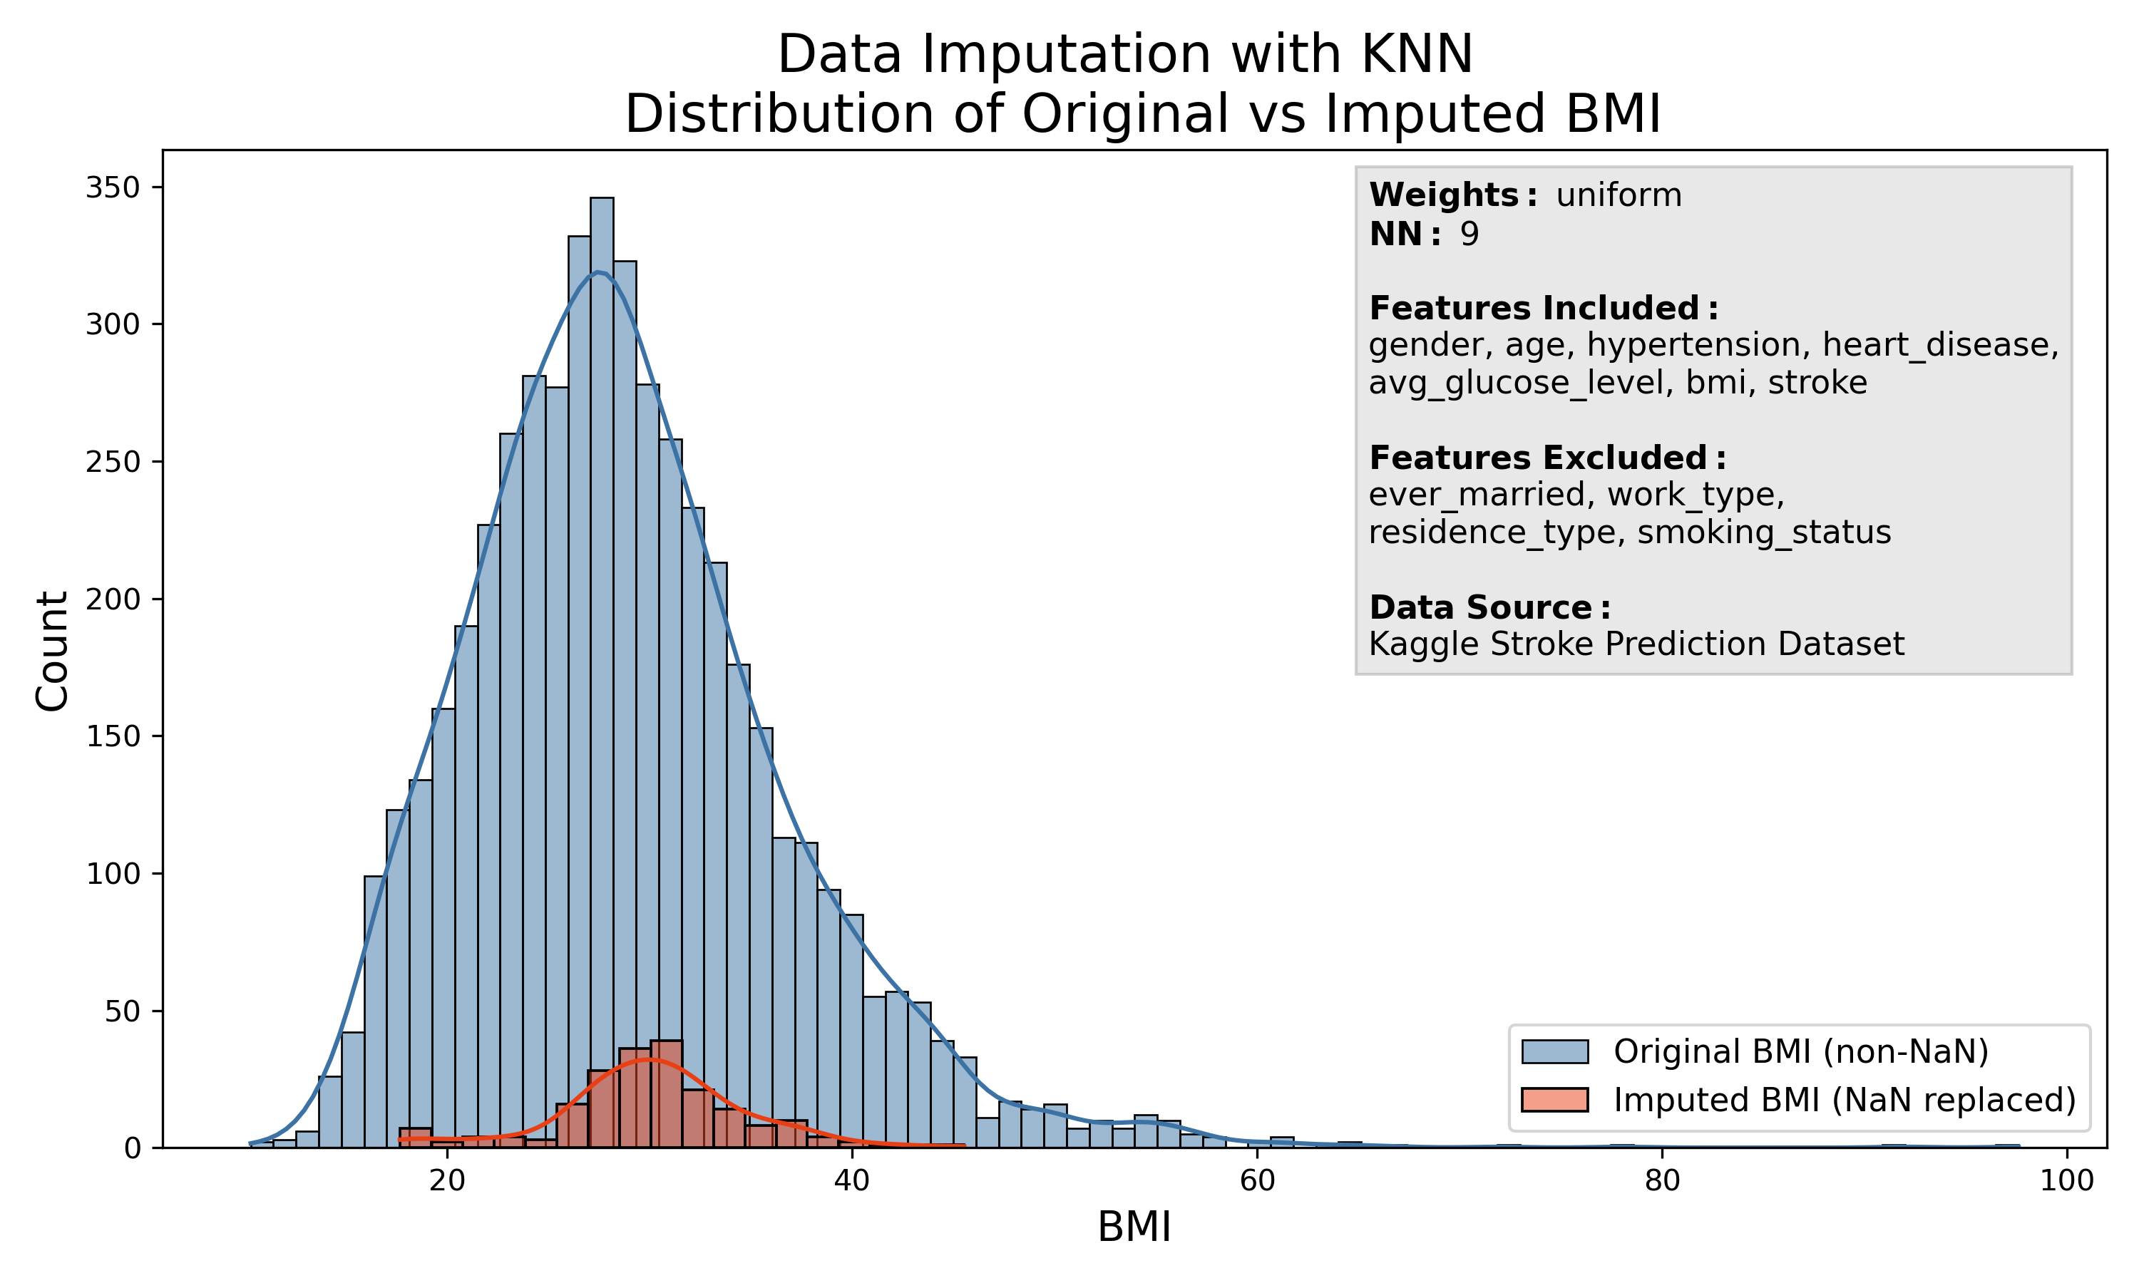
Problems with the Data:
Imbalance
Confounding factors: pediatric population
Lack of context related with data collection method
Variability: Age, BMI, and Average Glucose Levels
  ADA Classification
  CDC BMI Classification
  Canadian Age Classification
Missing Data:
  BMI: NaN values
  Smoking status: Unknown
Notes:
Mariluz: Imbalance, Confunding factors
Linday: Lack of context, missing data, variability

Slide 4
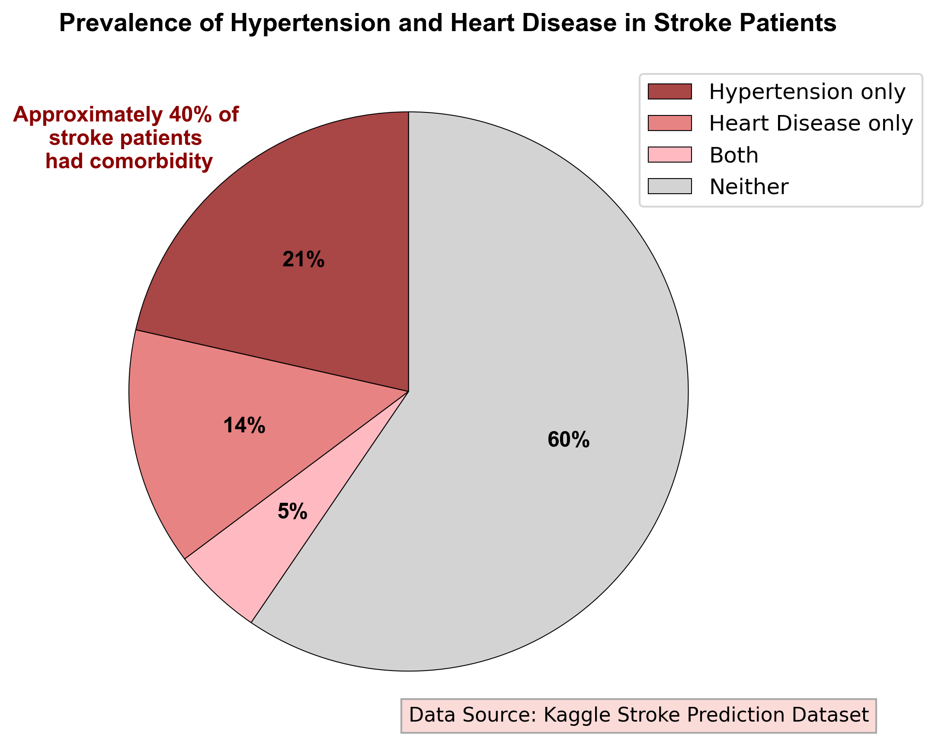
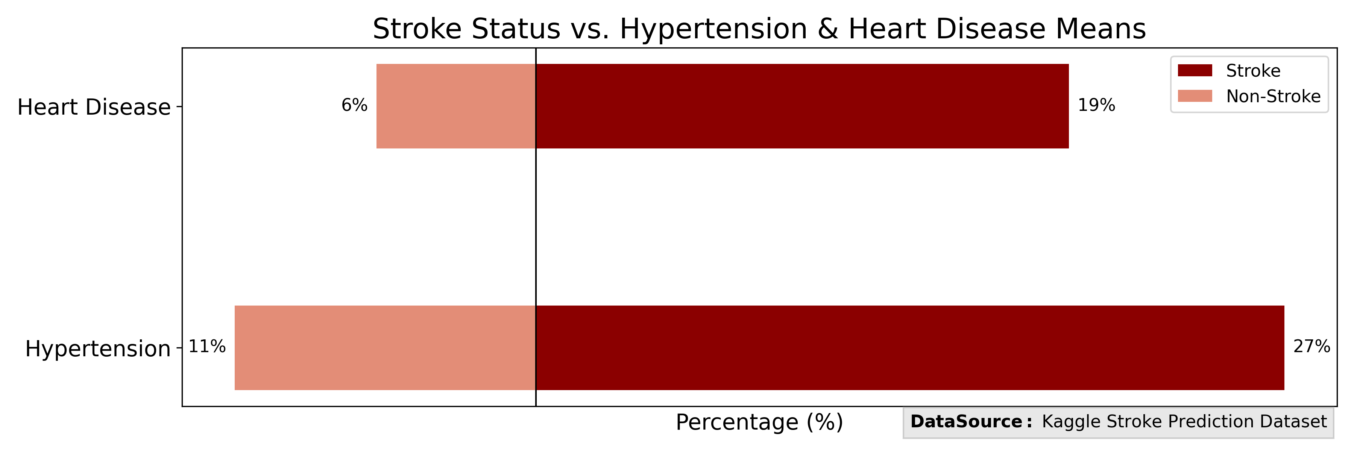
Feature Selection:
Excluded Features (Not significant, p-value > 0.5):
  Gender
  Marital Status (adjusted for age)
  Residence Type
Included Features (Significant, p-value < 0.5):
  Age
  Work Type
  Smoking Status
  Glucose Level
  BMI
  Hypertension
  Heart Disease
Notes:
Mariluz

Slide 5
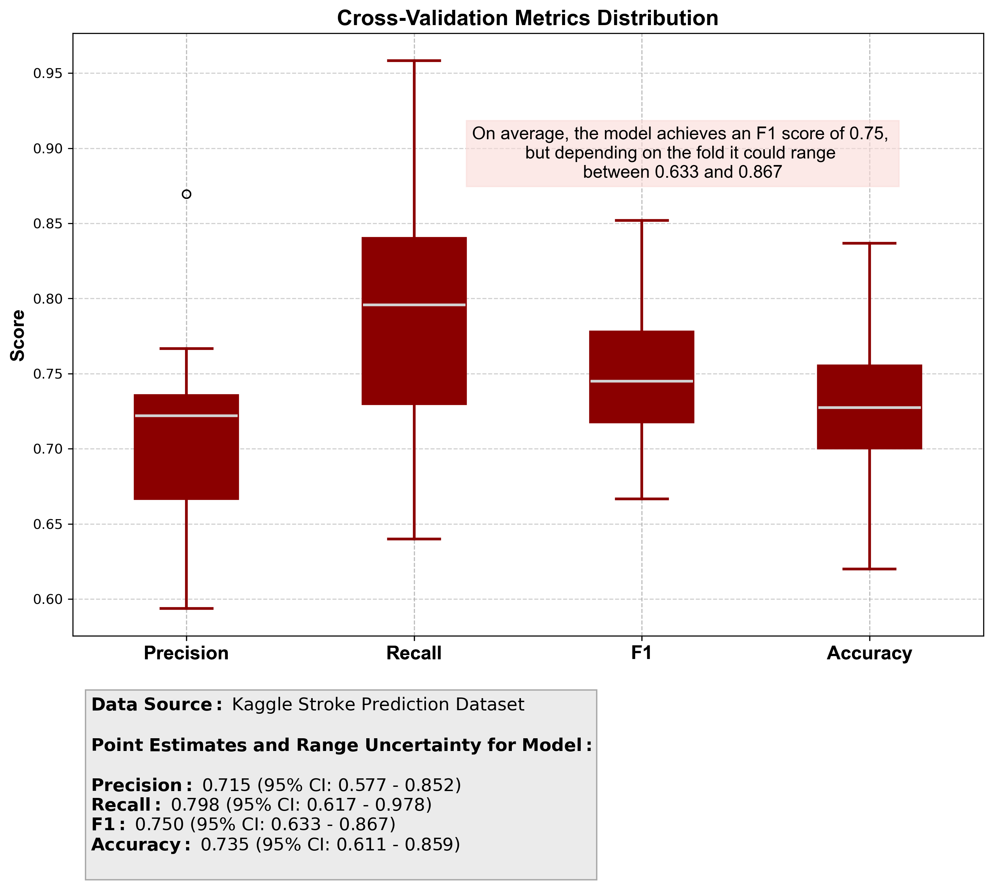
Model
Recall is consistently around 0.80, the model captures most true positives.
Precision is lower at 0.71, which suggests some false positives.
The F1 score is about 0.75, relatively balanced but skews towards recall. This is good in healthcare setting.
Accuracy is around 0.74, fairly good.
Overall, the model is strong at finding positives, but there is a trade‑off with precision.
In healthcare, being transparent about the range is critical and can build trust — stakeholders want to see variability.
Notes:
Lindsay

Slide 6
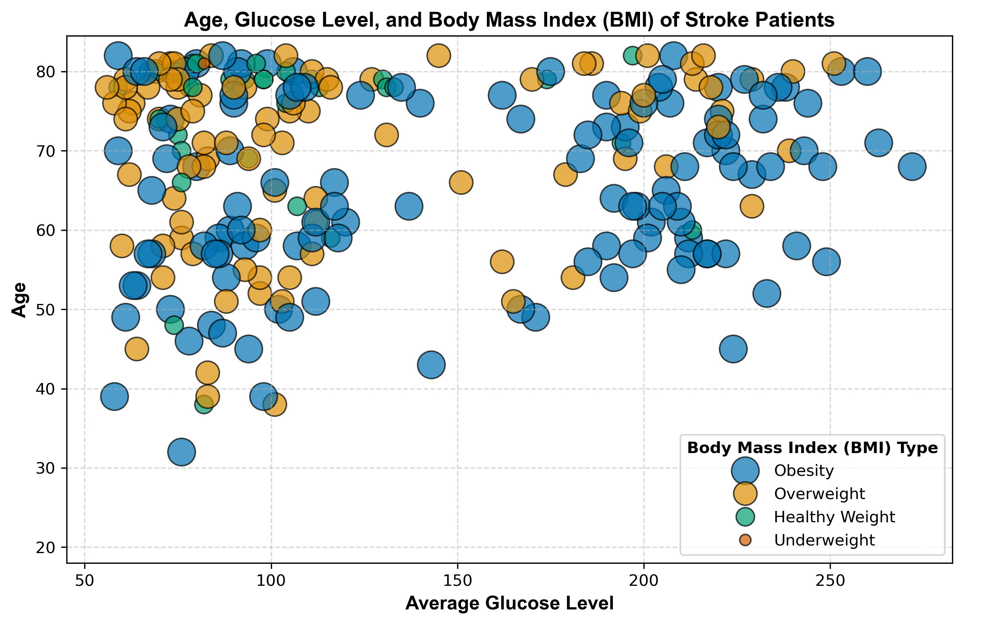
Team Specific Recomendations
The target population is:
  Individuals over 57 years old, with comorbidities as heard disease, hta, and pre-DM or DM . And Risk factors as overweight, formerly smoked or smokes.
  The analyst suggest healthy weight, healthy glucose average , and never smoke as protective factors.
Notes:
Mariluz

Slide 7
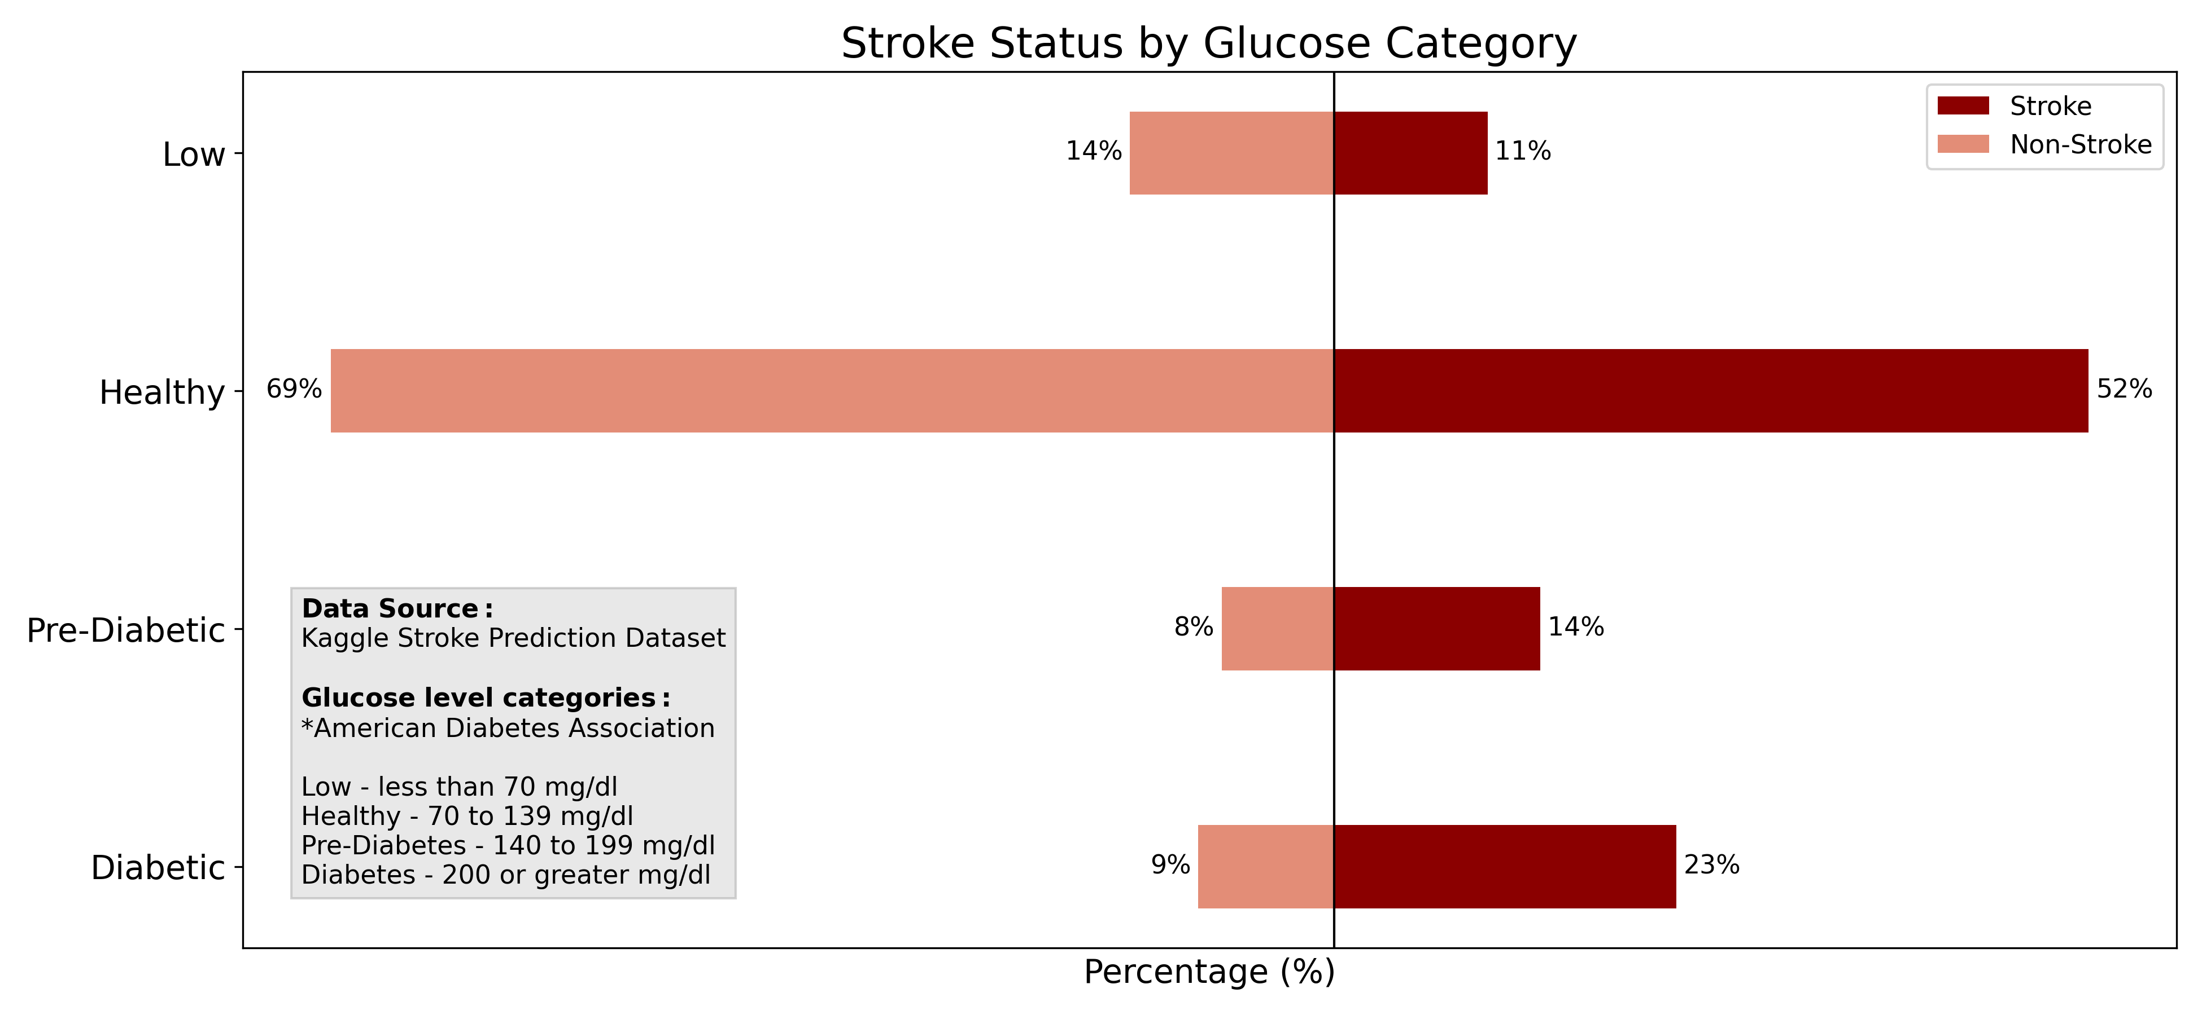
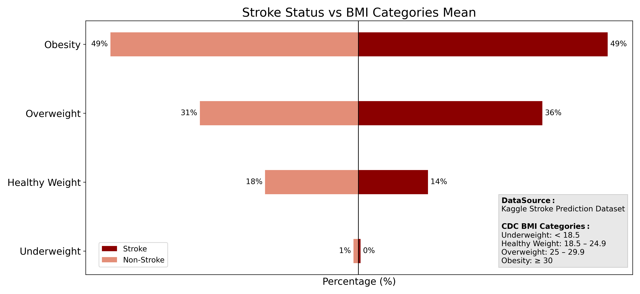
Key Data Insights:
Proper categorization of the dataset : The Key in analysis and model development.
Health data analysis: healthy individuals vs disease group
Correlation is not causation: protective and risk factors can emerge.
Notes:
Mariluz

Slide 8
Conclusion & Next Steps
Feature selection was the key in our data-driven approach to make an accurate model.
Our next steps in refining our model would be:
  Apply a larger stroke population dataset combined with greater data collection context, and additional relevant features.
  Leverage SHAP analysis to understand what is driving predictions.
  Consider tracking performance across various demographic segmentations and audit model for potential biases.
  Validate the model on external clinical stroke datasets.
Notes:
Lindsay

Slide 9
Thank You
Feel free to write us your questions and
Lets conect by LikedIn!
Mariluz Lopez Zamora
www.linkedin.com/in/mlopezza
Joshua Okojie
www.linkedin.com/in/abayomiokojie/

